Slide 1
Module 1: Introduction to OOAD
(Object-Oriented Analysis and Design)

Slide 2
Objectives
Why OO?
What is OOAD?
How to do OOAD?
SDLC
RUP (Process Model)
UML (Modelling tool)

Slide 3
Why Object-Oriented?
“The "software crises" came about when people realized the major problems in software development were … caused by communication difficulties and the management of complexity” [Budd]
The Whorfian Hypothesis:
Human beings … are very much at the mercy of the particular language which has become the medium of expression for their society … the 'real world' is … built upon the language habits … We cut nature up, organize it into concepts, and ascribe significances as we do, largely because we are parties to an agreement to organize it in this way … and is codified in the patterns of our language.


What kind of language can alleviate difficulties with
communication & complexity hopefully well?

Slide 4
Why Object-Oriented -> What is a model and why?
A model is a simplification of reality.
E.g., a miniature bridge for a real bridge to be built
A model is our simplification of our perception of reality
A model is an abstraction of something for the purpose of understanding, be it the problem or a solution.
To understand why a software system is needed, what it should do, and how it should do it.
To communicate our understanding and to detect misunderstandings and miscommunications.
To reduce complexity and ambiguity in the requirements.

Slide 5



What is Object-Orientation? - What is Object?
An "object" is anything to which a concept applies
Artifacts drawn from the problem domain or solution space.
E.g., a living person in the problem domain, a software component in the solution space.
A structure that has identity and properties and behavior
It is an instance of a collective concept, i.e., a class.

Slide 6

What is Object-Orientation
- Abstraction and Encapsulation
Abstraction
Focus on the essential
Omits tremendous amount of details
…Focus on what an object “is and does”
Encapsulation
a.k.a. information hiding
Objects encapsulate:
property
behavior as a collection of methods invoked by messages

Slide 7
What is Object-Orientation
- Another Example of Abstraction and Encapsulation
Class Car
Attributes
Model
Location
#Wheels = 4
Operations
Start
Accelerate
<<instanceOf>>
<<instanceOf>>
<<instanceOf>>
What is generalization?

Slide 8
What is Object-Orientation? - Class
<<instanceOf>>
Class Car
Attributes
Model
Location
#Wheels = 4
Operations
Start
Accelerate
<<instanceOf>>
<<instanceOf>>
What is CLASS?
a collection of objects that share common properties, attributes, behavior and semantics, in general.
A collection of objects with the same data structure (attributes, state variables) and behavior (function/code/operations) in the solution space.
Classification
Grouping of common objects into a class
Instantiation.
The act of creating an instance.

Slide 9
What is Object-Orientation
- Subclass vs. Superclass
Specialization: The act of defining one class as a refinement of another.
Subclass: A class defined in terms of a specialization of a superclass using inheritance.
Superclass: A class serving as a base for inheritance in a class hierarchy
Inheritance: Automatic duplication of superclass attribute and behavior definitions in subclass.
Person
name
SSN
Student
Employee
std-id
emp-id
level
age

Slide 10
What is Object-Orientation - Polymorphism
Objects of different classes respond to the same message differently.
Person
name
SSN
Student
Employee
payTuition
std-id
level
emp-id
payTuition
Part-time
Full-time
payTuition
payTuition

Slide 11
What is Object-Orientation
- Example of Encapsulation and public Interfaces
Information hiding - all data should be hidden within a class, at least in principle.
make all data attributes private
provide public methods to get and set the data values
e.g. Grade information is usually confidential, hence it should be kept
private to the student. Access to the grade information should be
done through public interfaces, such as setGrade and getGrade
Student
setGrade
std-id
level
grade
payTuition
setGrade()
getGrade()
getGrade

Slide 12
What is Object-Orientation? -State
What is STATE?
"State" is a collection of association an object has with other objects and object types.
What is STATE CHANGE?
A "state change" is the transition of an object from one state to another.
What is EVENT?
An "event" is a noteworthy change in state [Rumbaugh]
Work out an example!

Slide 13
What is Object-Oriented Application?
Collection of discrete objects, interacting with each other
Objects have property and behavior (causing state transition)
Interactions through message passing
(A sender object sends a request (message) to another object (receiver)
to invoke a method of the receiver object’s)
O1
O2
Data
m1
Data
Fn
Fn
m3
m2
O3
{m in Fn}
Data
Fn

Slide 14
What is OOAD?
Analysis — understanding, finding and describing concepts in the problem domain.
Design — understanding and defining software solution/objects that represent the analysis concepts and will eventually be implemented in code.
OOAD — Analysis is object-oriented and design is object-oriented. A software development approach that emphasizes a logical solution based on objects.
Traceability!
Involves both a notation and a process

Slide 15
Rational Unified Process Model (RUP) – Where to Use OO?
Lifecycle
Requirements Elicitation
Traceability!
Requirements Analysis/Specification
Quality Assurance
Design
Maintenance
Implementation
Testing
Deployment
Something missing?
Maintenance
What’s yours like?

Slide 16
Rational Unified Process Model (RUP)
A standardized approach to analysis and design helps to ensure that all necessary tasks are understood and completed in software development.
Requirements analysis and OOA/D needs to be presented and practiced in the context of some development process.
Here, an agile (light, flexible) approach to well-known Unified Process (UP) is used as a sample iterative development process.
Iterations
Iterations
Iterations
Iterations
Inception
Elaboration
Construction
Transition

Slide 17
Unified Modelling Language (UML)
Use-Case (relation of actors to system functions)
Class (static class structure)
Object (same as class - only using class instances – i.e. objects)
State (states of objects in a particular class)
Sequence (Object message passing structure)
Collaboration (same as sequence but also shows context - i.e. objects and their relationships)
Activity (sequential flow of activities i.e. action states)
Component (code structure)
Deployment (mapping of software to hardware)

Slide 18
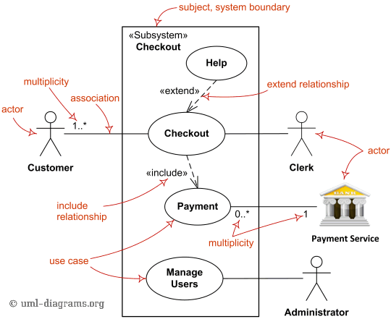
UML Example : Use Case Diagram

Slide 19
Introduction to OOAD - Summary
Why
Once Software Crisis due to Communication and Complexity
Languages, Concepts, Models
OO for Conceptual Modeling
What
Fundamental OO Concepts
A little taste of UML
How
OO development processes & (Design) Patterns

